Slide 1
Operating System

Slide 2
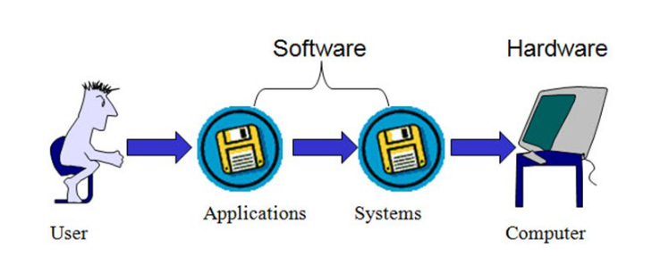
What is an Operating System?

Slide 3
What is an Operating System?
An operating system (OS) is a program that acts as an interface between the system hardware and the user.
Moreover, it handles all the interactions between the software and the hardware.
All the working of a computer system depends on the OS at the base level. Further, it performs all the functions like handling memory, processes,files,device management etc.
Applications like Browsers, MS Office,Games,Anti-virus,Audio & Video players etc., need some environment to run and perform its tasks. OS provides that environment.

Slide 4
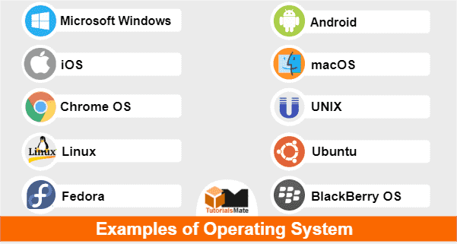
Eg:

Slide 5
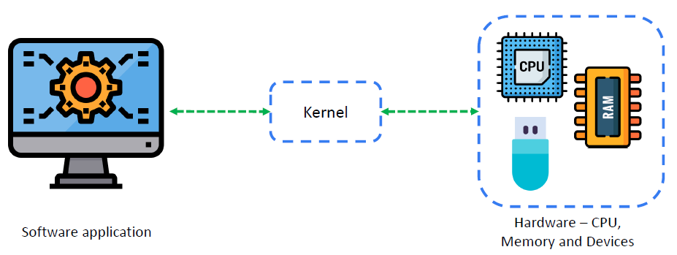
What is Kernel?

Slide 6
What is Kernel?
The kernel is a computer program which is the heart of a computer's operating system and generally has complete control over everything in the system.
This kernel is relatively a small piece of code that is embedded on the hardware.
Actually it is a collection of programs that are mostly written in c.
Every Operating system has a kernel (just one) that gets automatically loaded on to the memory as soon as the system is booted.
As the kernel sits on the hardware it can directly communicate with the hardware.

Slide 7
Objectives of OS:
Efficiency : The operating system increases the production efficiency. This is because the system configuration takes less time. By default, the operating system handles system tasks such as allocating resources to processes and resolving conflicts between different programs and users. This saves the user time and results in a more efficient result.
Hardware abstraction : The operating system performs a good job of concealing the computer's intricate details. The user can fully utilise the computer hardware without having to cope with the accompanying difficulties. The operating system coordinates communication between user programs and computer hardware.
Convenience : In the absence of an operating system, users would have to deal with the hardware directly without access to the pre-configured utility packages that come with an operating system. This would make using a computer extremely inconvenient. Operating systems allow users to go right to work on the tasks they want to do without dealing with the burden of setting up the system beforehand.
System resource management : The operating system serves as a neutral arbitrator. It serves a management role in the computer system by ensuring equitable resource distribution among various operations and consumers.

Slide 8
Functions of Operating System :
Memory Management
Processor Management
Device Management
File Management
Security Management
Error detection & Recovery
Interprocess Communication

Slide 9
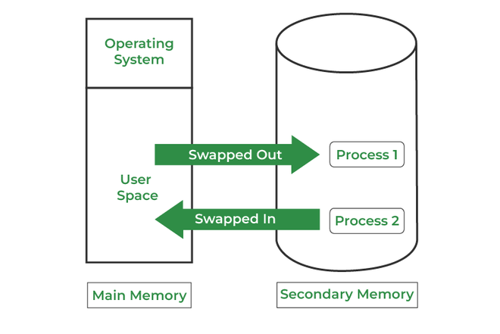
Memory Management

Slide 10
Memory Management
It is the management of the main or primary memory.
Whatever program is executed, it has to be present in the main memory.
Main memory is a quick storage area that may be accessed directly by the CPU.
When the program is completed, the memory region is released and can be used by other programs.
Therefore, there can be more than one program present at a time. Hence, it is required to manage the memory.
The operating system:
Allocates and deallocates the memory.
Keeps a record of which part of primary memory is used by whom and how much.
Distributes the memory while multiprocessing.
In multiprogramming, the operating system selects which processes acquire memory when and how much memory they get

Slide 11
Processor Management/Scheduling
A Program does nothing unless its instructions are executed by a CPU.
A program in execution is called a process.
In order to accomplish its task, process needs the computer resources.
There may exist more than one process in the system which may require the same resource at the same time.
Therefore, the operating system has to manage all the processes and the resources in a convenient and efficient way.
When more than one process runs on the system the OS decides how and when a process will use the CPU. Hence, the name is also CPU Scheduling.
The OS:
    Allocates and deallocates processor to the processes.
    Keeps record of CPU status.
    Providing mechanisms for process synchronization.

Slide 12
Algorithms used for CPU scheduling are as follows:
First Come First Serve (FCFS)
Shortest Job First (SJF)
Round-Robin Scheduling
Priority-based scheduling etc.

Slide 13
Device Management
Device management in an operating system means controlling the Input/Output devices like disk, microphone, keyboard, printer, magnetic tape, USB ports, camcorder, scanner, other accessories.
The processes may require devices for their use. This management is done by the OS.
The OS:
    Allocates and deallocates devices to different processes.
    Keeps records of the devices.
    Decides which process can use which device for how much time.

Slide 14
File Management
File management in operating system is nothing but software that handles or manages the files (binary, text, pdf, docs, audio, video, etc.) present in computer software.
The file system in the operating system is capable of managing individual as well as groups of files present in the computer system.
The file system in operating system tells us about the location, owner, time of creation and modification, type, and state of a file present on the computer system.
The OS:
    Keeps records of the status and locations of files.
    Allocates and deallocates resources.
    Decides who gets the resources.

Slide 15
Security Management:
OS security refers to the processes or measures taken to protect the operating system from dangers, including viruses, worms, malware, and remote hacker intrusions.
Operating system security comprises all preventive-control procedures that protect any system assets that could be stolen, modified, or deleted if OS security is breached.

Slide 16
Error Detection & Recovery:
It is the process of detecting and recovering from errors. The operating system must detect errors such as hardware failures, software bugs, and user errors. It must also recover from these errors in a way that minimizes data loss and system downtime.

Slide 17
Interprocess Communication:
It is the process of allowing different processes to communicate with each other. The operating system must provide mechanisms for processes to share data and resources and coordinate their activities.

Slide 18
Types of Operating Systems:
Batch operating system
Time-sharing operating systems
Distributed operating System
Network operating System
Real Time operating System

Slide 19
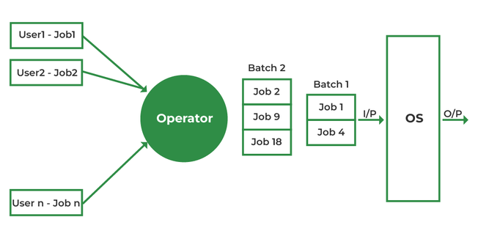
1.Batch operating system

Slide 20
1.Batch operating system
Batch processing was very popular in the 1970s. The jobs were executed in batches.
Users using batch operating systems do not interact directly with the computer.
Each user prepares their job using an offline device like a punch card and submitting it to the computer operator.
Jobs with similar requirements are grouped and executed as a group to speed up processing.
Once the programmers have left their programs with the operator, they sort the programs with similar needs into batches.

Slide 21
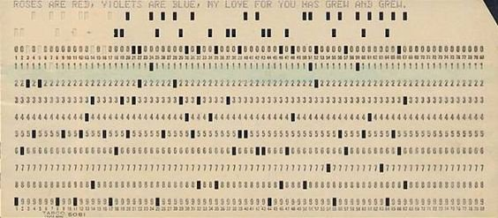

Punch Card:

Slide 22
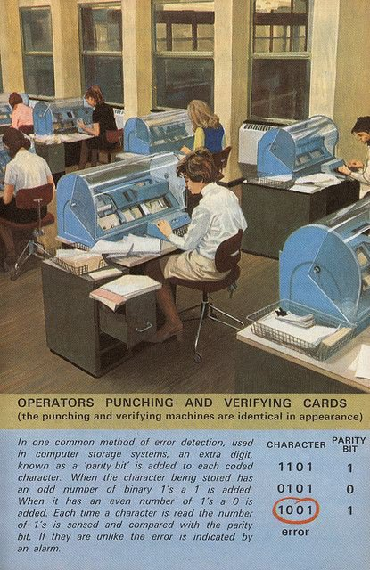
How Programmers write program using Punch Card.

Slide 23
Advantages:
This system can easily manage large jobs again and again.
The batch process can be divided into several stages to increase processing speed.
When a process is finished, the next job from the job spool is run without any user interaction.
CPU utilization gets improved.

Slide 24
Disadvantages:
When a job fails once, it must be scheduled to be completed, and it may take a long time to complete the task.
Computer operators must have full knowledge of batch systems.
The computer system and the user have no direct interaction.
If a job enters an infinite loop, other jobs must wait for an unknown period of time.
Applications: Payroll systems, Bank statements, Telephone bill generation

Slide 25
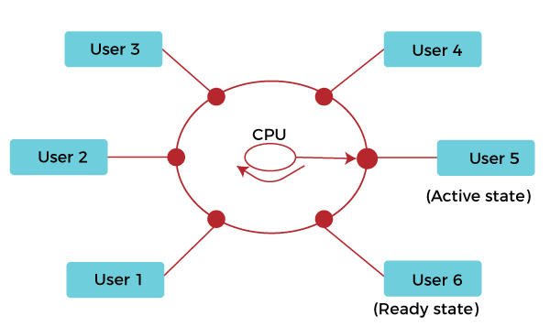
2.Time-sharing operating systems

Slide 26
2.Time-sharing operating systems
Time-sharing is a technique that enables many people located at various terminals to use a particular computer system simultaneously.
Time-sharing operating systems or Multitasking is a logical extension of Multiprogramming.
In this time-sharing Operating system, many processes are allocated with computer resources in respective time slots.
In this, the processor's time is shared with multiple users. That's why it is called a time-sharing operating system.
It has a fixed time slice for the different processes. Its main purpose is interactive response time.
This time duration is known as time slot, time slice, or quantum.

Slide 27
only one process runs at a time but, the switching between the processes is very fast. Hence, the user feels that all the processes are running at the same time.
Advantages:
Response time of CPU reduces.
Idle time of CPU reduces.
Each task/process gets an equal time slot to execute.
Disadvantages:
Communication is very important to maintain. Lack of communication can affect the whole working.
Requires high specification of hardware
It has a problem of reliability

Slide 28
Some examples of Time-sharing operating systems are:
UNIX
Multics
Linux
Windows 2000 server
Windows NT server

Slide 29
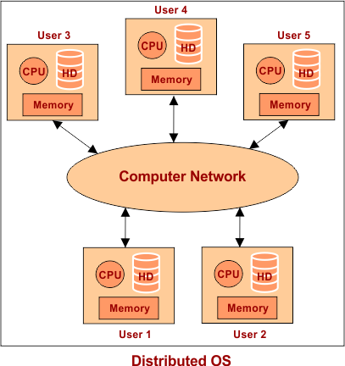
3.Distributed Operating System:

Slide 30
3. Distributed Operating System
A distributed operating system is one in which several computer systems connected through a single communication channel.
Moreover, these systems have their individual processors and memory.
These processors communicate through high-speed buses or telephone lines.
These individual systems that connect through a single channel are considered as a single unit.
We can also call them loosely coupled systems. The individual components or systems of the network are nodes.

Slide 31
Types of Distributed Operating System
1. Client/Server Systems
In this system, the client requests the server for a resource. On the other hand, the server provides this resource to the client.
One client contacts only a single server at a time. Whereas a single server can deal with multiple clients simultaneously.
The clients and servers connect through a computer network in the system.
Examples of computer applications that use the client–server model are email, network printing, and the World Wide Web.

Slide 32
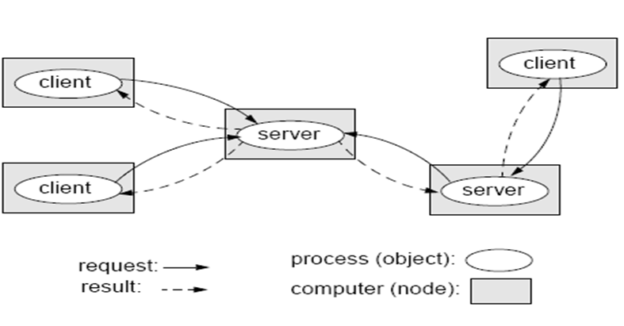
Client/Server Systems

Slide 33
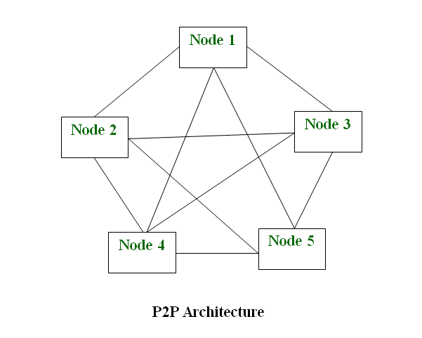
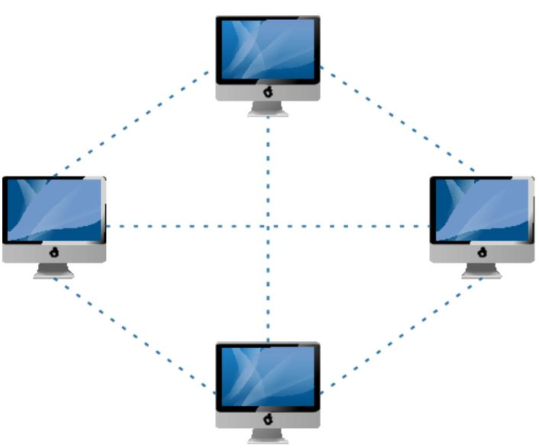
2. Peer to Peer Systems

Slide 34
2. Peer to Peer Systems
Examples of Distributed Operating System:
In this system, the nodes play an important role.
All the work equally divides among the nodes.
Furthermore, these nodes can share data or resources as per the requirement. Again, they require a network to connect.
Here each node acts as a server and thus there is no central server in the network. This allows the sharing of a huge amount of data
AIX operating system for IBM RS/6000 computers.
Solaris operating system for SUN multiprocessor workstations.
Mach/OS is a multitasking and multithreading UNIX compatible operating system.
Windows
Examples of computer applications that use the Peer to Peer model are
File Sharing
IP Telephony ( Skype is one good example of a P2P application in VoIP)

Slide 35
Advantages:
The load on the system decreases.
If one system stops it will not affect the other.
The system shares a workload that makes calculations easy.
Disadvantages:
The cost for set up is more.
Failure of the main system(Server) will affect the whole system.
Programming is complex.

Slide 36
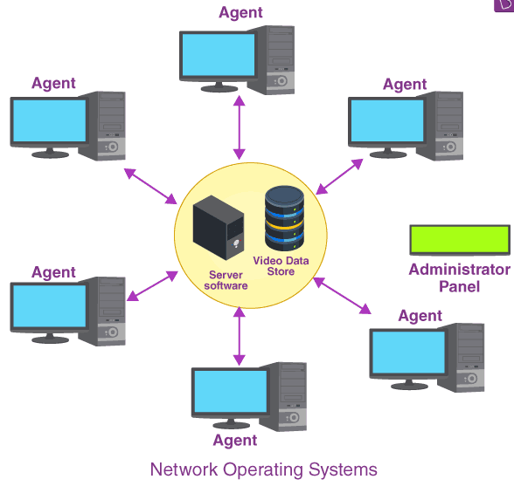
4.Network operating system (NOS) :
Examples of Network Operating systems :
Microsoft Windows Server
UNIX/Linux
Artisoft’s LANtastic

Slide 37
4.Network operating system (NOS)
a network operating system(NOS) is software that connects multiple devices and computers on the network and allows them to share resources on the network.
An Operating system, which includes software and associated protocols to communicate with other computers via a network conveniently and cost-effectively, is called Network Operating System..
Following are the main functions of NOS :
Printers and application sharing on the network.
File systems and database sharing.
Provide good security by using functionality like user authentication and access control.
Create backups of data.

Slide 38
Types of Network operating systems :
Peer to Peer :
Peer-to-peer network operating systems allow sharing resources and files with small-sized networks and having fewer resources. In general, peer-to-peer network operating systems are used on LAN.
Client/server :
Client-server network operating systems provide users access to resources through the central server. This NOS is too expensive to implement and maintain. This operating system is good for the big networks which provide many services.

Slide 39
Advantages of Network operating systems :
Highly stable due to central server.
Provide good security.
Upgradation of new technology and hardware can be easily implemented in the network.
Provide remote access to servers from different locations.
Disadvantages of Network operating systems :
Depend on the central location to perform the operations.
High cost to buying server.
Regular updating and maintenance are required.

Slide 40
5.Real Time operating System
The real-time operating systems are used in real-time systems where the time constraints are fixed and followed strictly.
This means that the time for processing and responding is very small.
Moreover, the system should perform the given task in a fixed time otherwise, it results in a system failure.
Response Time is the time within which the system takes the input, processes the data, and gives the results. Moreover, they are used in systems like robots, missile launches, airplanes, etc.

Slide 41
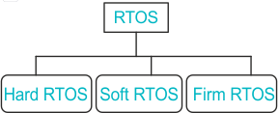
Types of RTOS:

Slide 42
1. Hard Real-Time Systems:
In this, the time constraint is very short and strict. Even seconds of delay is not acceptable. Therefore, it is compulsory to complete the task within the given time only.
Examples : Airplanes systems, Medical treatment systems, etc.
2. Soft Real-Time Systems:
As the name suggests, the system handles the deadlines softly. This means that if there are small delays in the system, it is acceptable.
Examples: Online Transaction systems, Web browsing, Computer games, etc
3.Firm Real-Time Systems:
Firm real-time tasks are such type of real-time tasks which are associated with time bound and the task need to produce the result within the deadline.
Although firm real-time task is different from hard real-time task as in hard real-time once deadline is crossed and task is not completed, system fails but in case of firm real-time task even after the passing of deadline, system does not fail.
Examples :1. Video conferencing 2. Satellite based tracking

Slide 43
Advantages of RTOS
They have no errors.
Due to their small size, they can be easily added to other systems.
Disadvantages of RTOS
Algorithms are complex.
System resources are expensive.

Slide 44
Services of Operating System
Program execution
Input Output Operations
Communication between Process
File Management
Memory Management
Process Management
Security and Privacy
Resource Management
User Interface
Networking
Error handling
Time Management

Slide 45
Services of OS
Program Execution
It is the Operating System that manages how a program is going to be executed. It loads the program into the memory after which it is executed. The order in which they are executed depends on the CPU Scheduling Algorithms. A few are FCFS, SJF, etc. When the program is in execution, the Operating System also handles deadlock i.e. no two processes come for execution at the same time. The Operating System is responsible for the smooth execution of both user and system programs. The Operating System utilizes various resources available for the efficient running of all types of functionalities.
Input Output Operations
Operating System manages the input-output operations and establishes communication between the user and device drivers. Device drivers are software that is associated with hardware that is being managed by the OS so that the sync between the devices works properly. It also provides access to input-output devices to a program when needed.

Slide 46
Services of OS
Communication between Processes
The Operating system manages the communication between processes. Communication between processes includes data transfer among them. If the processes are not on the same computer but connected through a computer network, then also their communication is managed by the Operating System itself.
File Management
The operating system helps in managing files also. If a program needs access to a file, it is the operating system that grants access. These permissions include read-only, read-write, etc. It also provides a platform for the user to create, and delete files. The Operating System is responsible for making decisions regarding the storage of all types of data or files, i.e, floppy disk/hard disk/pen drive, etc. The Operating System decides how the data should be manipulated and stored.

Slide 47
Services of OS
Memory Management
Let’s understand memory management by OS in simple way. Imagine a cricket team with limited number of player . The team manager (OS) decide whether the upcoming player will be in playing 11 ,playing 15 or will not be included in team , based on his performance . In the same way, OS first check whether the upcoming program fulfil all requirement to get memory space or not ,if all things good, it checks how much memory space will be sufficient for program and then load the program into memory at certain location. And thus , it prevents program from using unnecessary memory.
Process Management
Let’s understand the process management in unique way. Imagine, our kitchen stove as the (CPU) where all cooking(execution) is really happen and chef as the (OS) who uses kitchen-stove(CPU) to cook different dishes(program). The chef(OS) has to cook different dishes(programs) so he ensure that any particular dish(program) does not take long time(unnecessary time) and all dishes(programs) gets a chance to cooked(execution) .The chef(OS) basically scheduled time for all dishes(programs) to run kitchen(all the system) smoothly and thus cooked(execute) all the different dishes(programs) efficiently.

Slide 48
Services of OS
Security and Privacy
Security : OS keep our computer safe from an unauthorized user by adding security layer to it. Basically, Security is nothing but just a layer of protection which protect computer from bad guys like viruses and hackers. OS provide us defenses like firewalls and anti-virus software and ensure good safety of computer and personal information.
Privacy : OS give us facility to keep our essential information hidden like having a lock on our door, where only you can enter and other are not allowed . Basically , it respect our secrets and provide us facility to keep it safe.
Resource Management
System resources are shared between various processes. It is the Operating system that manages resource sharing. It also manages the CPU time among processes using CPU Scheduling Algorithms. It also helps in the memory management of the system. It also controls input-output devices. The OS also ensures the proper use of all the resources available by deciding which resource to be used by whom.

Slide 49
Services of OS
User Interface
User interface is essential and all operating systems provide it. Users either interface with the operating system through the command-line interface or graphical user interface or GUI. The command interpreter executes the next user-specified command.
A GUI offers the user a mouse-based window and menu system as an interface.
Networking
This service enables communication between devices on a network, such as connecting to the internet, sending and receiving data packets, and managing network connections.

Slide 50
Dual Mode Operations in Operating System

Slide 51
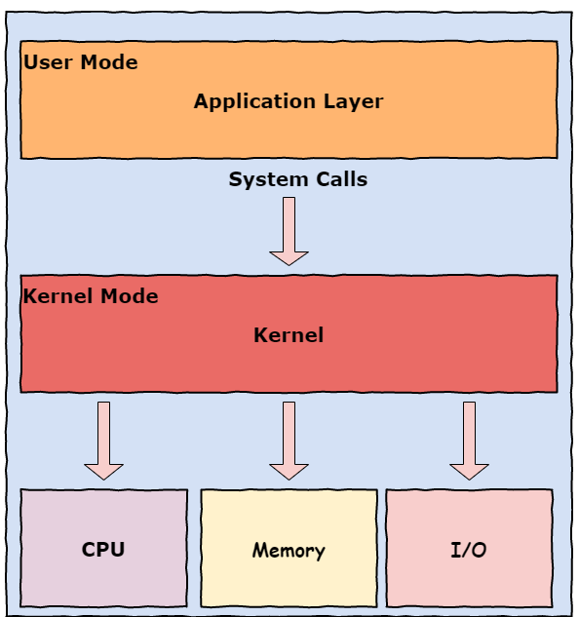

Slide 52
The dual-mode operations in the operating system protect the operating system from illegal users.
To ensure proper operating system execution, we must differentiate between machine code execution and user-defined code.
The processor switches between the two modes depending on what type of code is running on the processor.
Applications run in user mode, and core operating system components run in kernel mode.
Modern operating systems have two basic modes in which they can execute a certain program:
The user-mode [ Mode bit is 1 ]
The kernel-mode. [ Mode bit is 0 ]

Slide 53
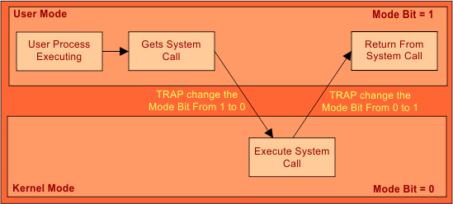
Mode bit is required to identify in which particular mode the current instruction is executing. If the mode bit is 1, it operates user mode, and if the mode bit is 0, it operates in kernel mode

Slide 54
When the computer system executes on behalf of a user application, the system is in user mode.
However, when a user application requests a service from the operating system via a system call, it must transition from user to kernel mode to fulfill the request. As we can say, this architectural enhancement is useful for many other aspects of system operation.
At system boot time, the hardware starts in kernel mode.
The operating system is then loaded and starts user applications in user mode.
Whenever a trap or interrupt occurs, the hardware switches from user mode to kernel mode, changing the mode bit's state to 0.
Thus, whenever the operating system gains control of the computer, it is in kernel mode.
The system always switches to user mode by setting the mode bit to 1 before passing control to a user program.

Slide 55
The User-Mode:
Every user process operates under the user mode.
In this mode, processes do not have direct access to the RAM or other hardware resources and have to make system calls to the underlying APIs to access these resources.
2. Kernel-Mode:
The system starts in the kernel mode when it boots up.
The kernel mode has direct access to all the underlying hardware resources.
In the kernel mode, all memory addresses are accessible and all CPU instructions are executable.
Kernel mode is usually reserved for drivers which need finer control over the hardware they are operating on.

Slide 56
System call and Types of system calls.
A System call is the programmatic way in which a computer program requests a service from the kernel of the operating system.
System call provides the services of the operating system to the user programs via Application Program Interface(API).
The program requests several services, and the OS responds by invoking a series of system calls to satisfy the request.
A system call can be written in assembly language or a high-level language like C or Pascal.
System calls are predefined functions that the operating system may directly invoke if a high-level language is used.
All programs needing resources must use system calls.

Slide 57
Services Provided by System Calls :
Process creation and management
Main memory management
File Access, Directory and File system management
Device handling(I/O)
Protection
Networking, etc.
Three most common APIs are:
Win32 API for Windows,
POSIX API (all versions of UNIX, Linux, and Mac OS X), and
Java API for the Java virtual machine (JVM)

Slide 58
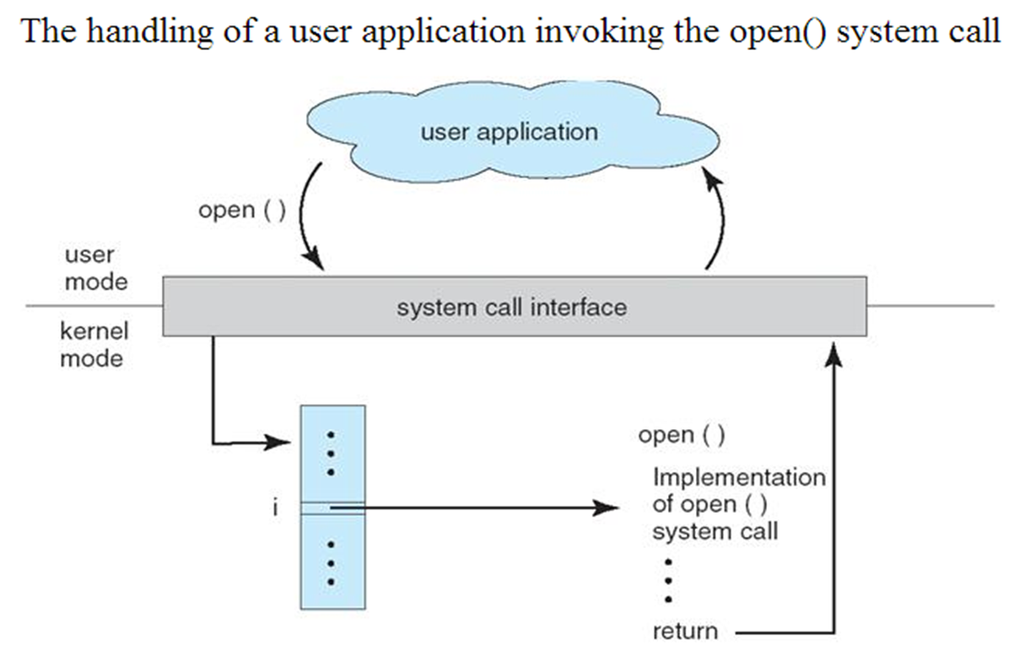

Slide 59
System Call Implementation
Typically, a number associated with each system call
System-call interface maintains a table indexed according to these Numbers
The system call interface invokes intended system call in OS kernel and returns status of the system call and any return values.
The caller need know nothing about how the system call is implemented.Just needs to obey API and understand what OS will do as a result Call.
Most details of OS interface hidden from programmer by API

Slide 60
Types of System Calls
Process control
File management
Device management
Information maintenance
Communication

Slide 61
Process control:
    Create process, Terminate process
    End, Abort
    Load, Execute
    Get process attributes, Set process attributes
    Wait for time
    Wait event, Signal event
    Allocate memory, Free memory
File management:
    Create file, Delete file
    Open, Close
    Read, Write, Reposition
    Get file attributes, Set file attributes

Slide 62
Device management:
    Request device, Release device
    Read, Write, Reposition
    Get device attributes, Set device attributes
    Logically attach devices, Logically detach devices
Information maintenance:
    Get time or date, Set time or date
    Get system data, Set system data
    Get process, file, or device attributes, Set process, file, or device attributes

Slide 63
Communications:
    Create communication connection, Delete communication connection
    Send messages, Receive messages
    Transfer status information
    Attach remote devices, Detach remote devices

Slide 64
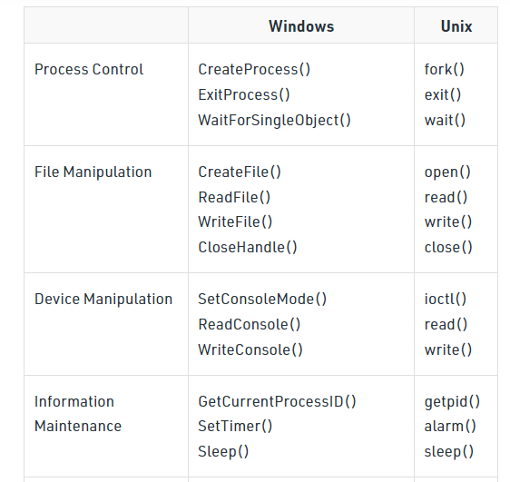
Eg:
Windows and Unix System Calls :

Slide 65
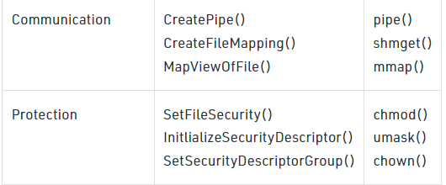
Eg:
Windows and Unix System Calls :

Slide 66
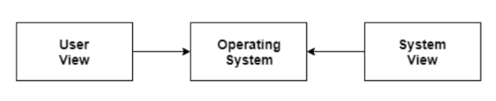
View Points
User view point
  Single user viewpoint
  Multiuser viewpoint
  Handheld user viewpoint
  Embedded user viewpoint
System viewpoint
  Resource allocation
  Control program

Slide 67
View Points(Contd.)
Single User View Point
Most computer users use a monitor, keyboard, mouse, printer, and other accessories to operate their computer system. In some cases, the system is designed to maximize the output of a single user. As a result, more attention is laid on accessibility, and resource allocation is less important. These systems are much more designed for a single user experience and meet the needs of a single user, where the performance is not given focus as the multiple user systems.
Multiple User View Point
Another example of user views in which the importance of user experience and performance is given is when there is one mainframe computer and many users on their computers trying to interact with their kernels over the mainframe to each other. In such circumstances, memory allocation by the CPU must be done effectively to give a good user experience. The client-server architecture is another good example where many clients may interact through a remote server, and the same constraints of effective use of server resources may arise.

Slide 68
View Points(Contd.)
Handheld User View Point
Moreover, the touchscreen era has given you the best handheld technology ever. Smartphones interact via wireless devices to perform numerous operations, but they're not as efficient as a computer interface, limiting their usefulness. However, their operating system is a great example of creating a device focused on the user's point of view.
Embedded System User View Point
Some systems, like embedded systems that lack a user point of view. The remote control used to turn on or off the tv is all part of an embedded system in which the electronic device communicates with another program where the user viewpoint is limited and allows the user to engage with the application.

Slide 69
View Points(Contd.)
Resource Allocation
The hardware contains several resources like registers, caches, RAM, ROM, CPUs, I/O interaction, etc. These are all resources that the operating system needs when an application program demands them. Only the operating system can allocate resources, and it has used several tactics and strategies to maximize its processing and memory space. The operating system uses a variety of strategies to get the most out of the hardware resources, including paging, virtual memory, caching, and so on. These are very important in the case of various user viewpoints because inefficient resource allocation may affect the user viewpoint, causing the user system to lag or hang, reducing the user experience.
Control Program
The control program controls how input and output devices (hardware) interact with the operating system. The user may request an action that can only be done with I/O devices; in this case, the operating system must also have proper communication, control, detect, and handle such devices.

Slide 70
Different approaches or Structures of Operating Systems
Simple structure
Monolithic Structure
Layered structure
Micro-kernel Structure
Modular structure

Slide 71
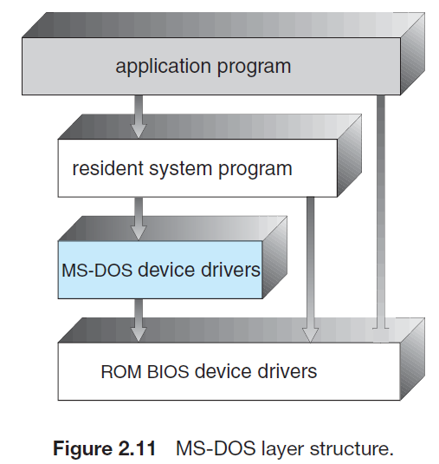
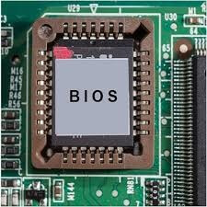
Simple structure:
Eg: MS-DOS

Slide 72
Simple structure:
Such operating systems do not have well defined structure and are small, simple and limited systems. Eg: MS-DOS
In MS-DOS, the interfaces and levels of functionality are not well separated.
For instance, application programs are able to access the basic I/O routines to write directly to the display and disk drives.
Such freedom leaves MS-DOS vulnerable to errant (or malicious) programs, causing entire system crashes when user programs fail.
Of course, MS-DOS was also limited by the hardware of its era.
In Intel 8088 there is no dual mode and no hardware protection, the designers of MS-DOS had no choice but to leave the base hardware accessible.

Slide 73
Advantages of Simple structure:
It delivers better application performance because of the few interfaces between the application program and the hardware.
Easy for kernel developers to develop such an operating system.
Disadvantages of Simple structure:
The structure is very complicated as no clear boundaries exists between modules.
It does not enforce data hiding in the operating system.

Slide 74
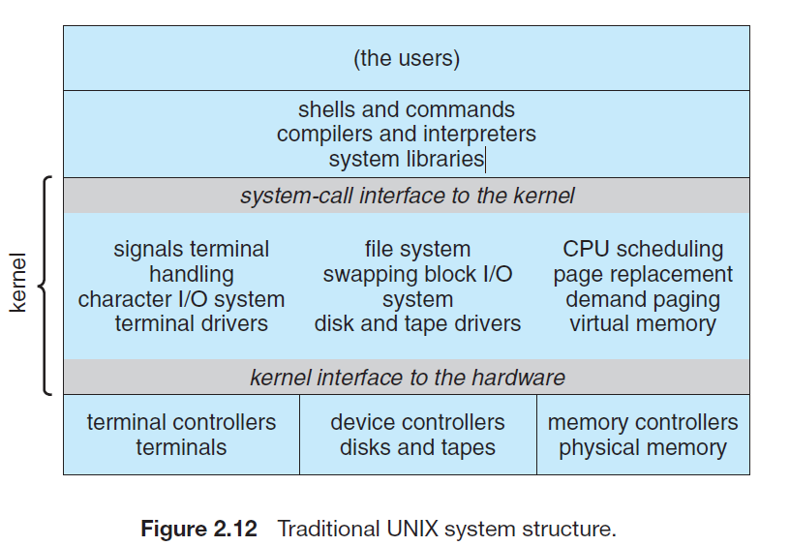
2.Monolithic Structure [Another limited structure]
Eg: UNIX OS

Slide 75
Like MS-DOS, UNIX initially was limited by hardware functionality.
It consists of two separable parts: [1] The kernel, [2] The system programs
The Kernel is further separated into a series of interfaces and device drivers, which have been added and expanded over the years as UNIX has evolved.We can view the traditional UNIX operating system as being layered to some extent, as shown in Figure.
Everything below the system-call interface and above the physical hardware is the kernel.
The kernel provides the file system, CPU scheduling,memory management, and other operating-system functions through system calls. Taken in sum, that is an enormous amount of functionality to be combined into one level.
This monolithic structure was difficult to implement and maintain.
This is an outdated operating system that was used in banks to accomplish minor activities.

Slide 76
Advantages of Monolithic structure:
It is simple to design and implement because all operations are managed by kernel only, and layering is not needed.
As services such as memory management, file management, process scheduling, etc., are implemented in the same address space, the execution of the monolithic kernel is relatively fast as compared to normal systems. Using the same address saves time for address allocation for new processes and makes it faster.
Disadvantages of Monolithic structure:
If any service in the monolithic kernel fails, the entire System fails because, in address space, the services are connected to each other and affect each other.
It is not flexible, and to introduce a new service

Slide 77
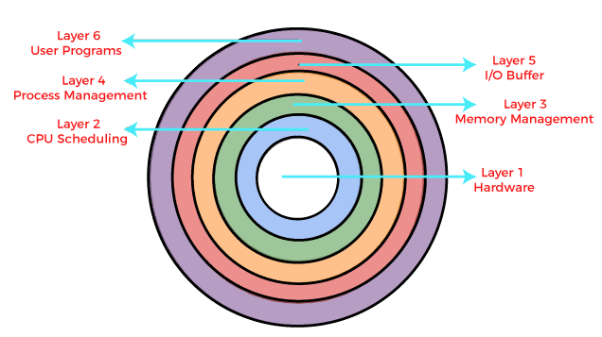
3.Layered structure:
Eg:
Windows
Linux
Unix
iOS
Android

Slide 78
In this type of structure, OS is divided into layers or levels. The hardware is on the bottom layer (layer 0), while the user interface is on the top layer (layer N).
A layered structure in an operating system refers to the organization of different software components of the system into distinct layers, where each layer provides a specific set of functionalities and services to the layer above it.
This layered approach makes it easier to design, implement, and maintain an operating system by separating the different components based on their level of abstraction and complexity.
The layers typically range from low-level hardware components, such as device drivers and interrupt handlers, to high-level application programming interfaces (APIs) and user-level applications.
By organizing the system into distinct layers, each layer can be developed and tested independently, which makes it easier to identify and fix issues.
Additionally, the layered structure provides a level of abstraction that makes it easier for developers to understand and work with the system.
This allows for greater flexibility and modularity in the operating system, making it easier to modify and update individual layers without affecting the overall system

Slide 79
A typical layered structure of an operating system may include the following layers, from lowest to highest:
Hardware layer: This layer consists of device drivers and firmware that directly interact with the hardware components of the computer system.
Kernel layer: This layer provides essential services to the system, such as memory management, process management, and file system management.
System services layer: This layer provides additional services to the kernel layer, such as networking, security, and input/output (I/O) operations.
API layer: This layer provides a set of interfaces for application developers to interact with the system services and perform operations on the system.
User-level applications layer: This layer includes all the user-level applications that run on top of the system, such as text editors, web browsers, and media players.

Slide 80
Advantages of Layered Structure:
Each layer has its functionalities, so work tasks are isolated, and abstraction is present up to some level.
Debugging is easier as lower layers are debugged, and then upper layers are checked.
Disadvantages of Layered Structure:
In Layered Structure, layering causes degradation in performance.
It takes careful planning to construct the layers since higher layers only utilize the functions of lower layers.

Slide 81
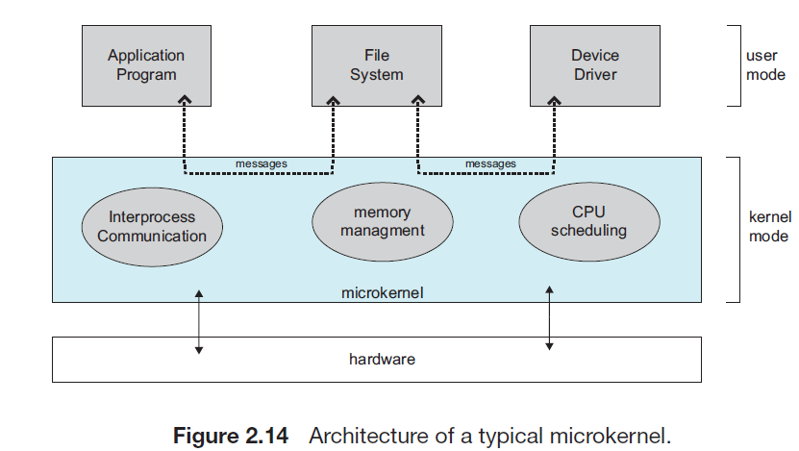
4.Micro-kernel Structure:
Eg: Mac OS

Slide 82
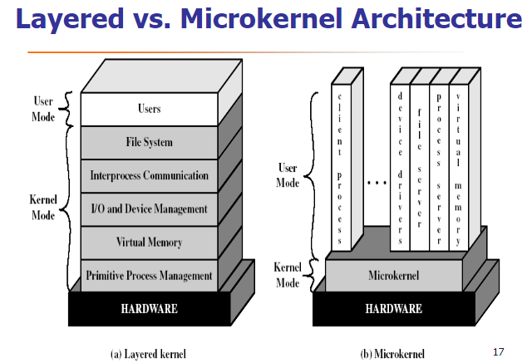

Slide 83
We have already seen that as UNIX expanded, the kernel became large and difficult to manage. In the mid-1980s, researchers at Carnegie Mellon University developed an operating system called Mach that modularized the kernel using the microkernel approach.
This method structures the operating system by removing all non essential components from the kernel and implementing them as system and user-level programs.
The result is a smaller kernel.So this structure called as Micro-kernel.
There is little consensus regarding which services should remain in the kernel and which should be implemented in user space.
Typically, however,microkernels provide minimal process and memory management, in addition to a communication facility.
The main function of the microkernel is to provide communication between the client program and the various services that are also running in user space.Communication is provided through “message passing”.

Slide 84
For example, if the client program wishes to access a file, it must interact with the file server. The client program and service never interact directly. Rather, they communicate indirectly by exchanging messages with the microkernel. (Fig 2.14)
One benefit of the microkernel approach is that it makes extending the operating system easier.
All new services are added to user space and consequently do not require modification of the kernel.
When the kernel does have to be modified, the changes tend to be fewer, because the microkernel is a smaller kernel.
Thus it is more secure and reliable as if any service fails then rest of the operating system remains untouched.
Mac OS is an example of this type of OS.

Slide 85
Advantages of Micro-kernel structure:
It allows the operating system to be portable between platforms.
As each Micro-Kernel is isolated, it is safe and trustworthy.
Because Micro-Kernels are smaller, they can be successfully tested.
If any component or Micro-Kernel fails, the remaining operating System is unaffected and continues to function normally.
Disadvantages of Micro-kernel structure:
Increased inter-module communication reduces system performance.
System is complex to be constructed.

Slide 86
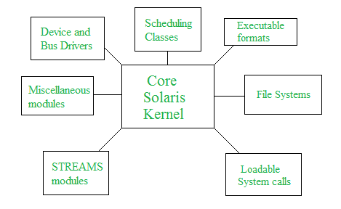
5.Modular structure :
Eg:
Solaris OS
Windows
Linux
Mac OS
Android
Solaris OS

Slide 87
5.Modular structure :
It is considered as the best approach for an OS.
A modular structure of an operating system refers to the organization of an operating system into different components or modules that can be developed, tested, and maintained independently of each other.
In a modular operating system, each module performs a specific set of functions and interacts with other modules through well-defined interfaces.
It involves designing of a modular kernel.
It resembles(seem like)layered structure due to the fact that each kernel has defined and protected interfaces but it is more flexible than the layered structure as a module can call any other module.

Slide 88
In a modular operating system, the kernel is the core component that interacts directly with the hardware and manages system resources.
Other modules, such as device drivers, file systems, network protocols, and user interface components, are built on top of the kernel and can be added or removed as needed without affecting the rest of the system.
The benefits of a modular structure include:
Easy maintenance: With a modular structure, it is easier to maintain and update individual components without affecting the entire operating system.
Improved scalability: A modular structure allows for the addition or removal of modules to support new hardware or software requirements.
Better fault isolation: Since each module performs a specific function, errors or faults can be isolated to that module, making it easier to diagnose and fix problems.
Increased reliability: A modular structure can help increase the reliability of an operating system by allowing for the use of redundant modules that can take over in case of a failure.

